Slide 1
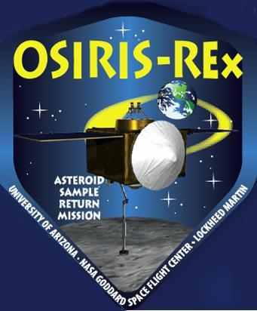



OSIRIS-REx Asteroid Sample Return (NASA New Frontiers Program)
Mentors: Christopher Shinohara and Anthony Ferro
Interns: Ina Kundu and Amanda Duron
Arizona Space Grant Consortium, University of Arizona, Tucson
April 21st, 2012

Slide 2
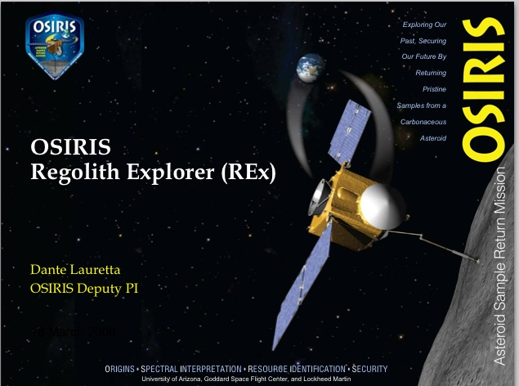
Overview
What is OSIRIS-REx?
The Mission
Current Status
Next Steps
Systems Information
http://chrisastro.webnode.com/news/another-week-of-space-related-events-from-around-the-world-and-in-orbit-/

Slide 3
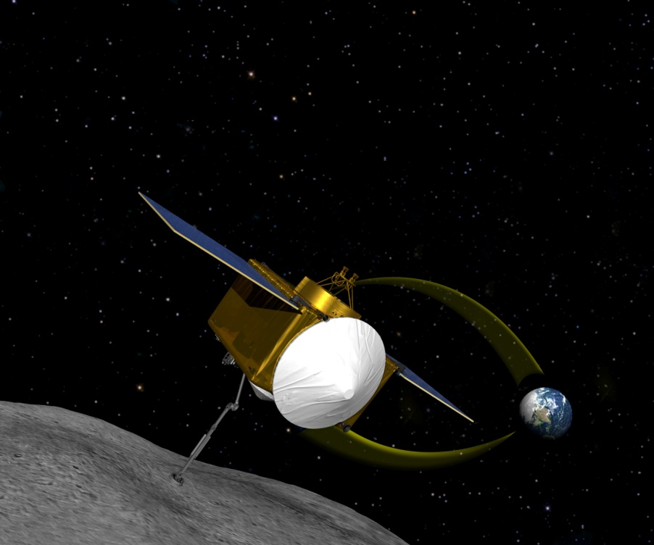
What is OSIRIS-REx?
Origins, Spectral Interpretation, Resource Identification, and Security Regolith Explorer (OSIRIS-REx)
A planetary science
mission
Part of NASA’s
New Frontier Program
http://www.universetoday.com/85953/nasa-selects-osiris-rex-as-first-us-asteroid-sampling-mission/

Slide 4
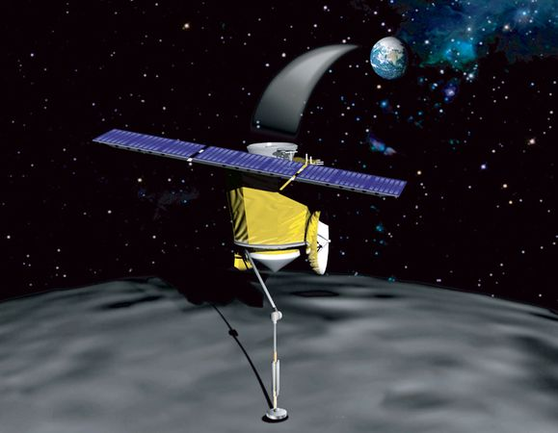
The Mission
14-year mission: May 2011 through 2025
Spacecraft scheduled to launch on September 20, 2016
Travel to asteroid will
take 3 years
Surface of asteroid
will be mapped for
6 months
Sample returns to
Earth for analysis in 2023
http://news.nationalgeographic.com/news/2010/08/100806-science-space-asteroid-impact-earth-osiris-rq36/

Slide 5
Objectives
Collect the first U.S. asteroid samples
Map the surface of asteroid 1999 RQ36
Examine its composition
Explore its regolith
Observe its orbit
Return samples to Earth

Slide 6
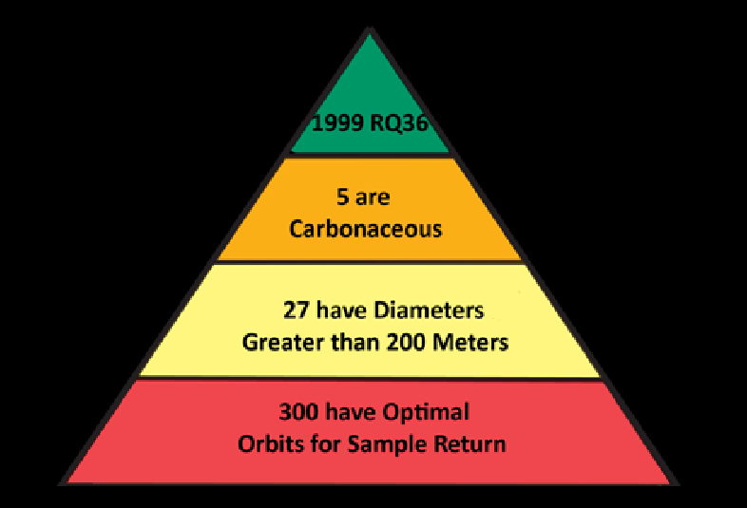
Asteroid 1999 RQ36
http://osiris-rex.lpl.arizona.edu/faq.html#faq5

Slide 7
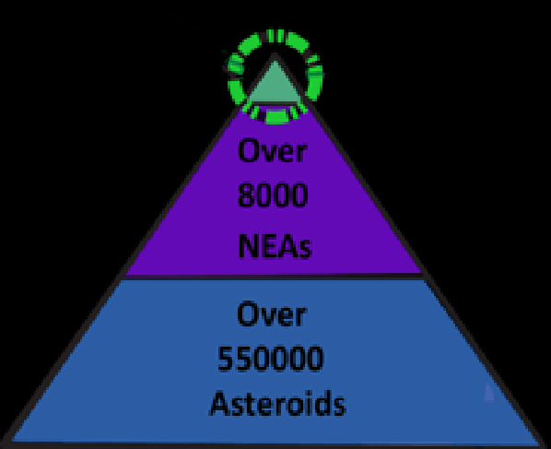
Asteroid 1999 RQ36
http://osiris-rex.lpl.arizona.edu/faq.html#faq5

Slide 8
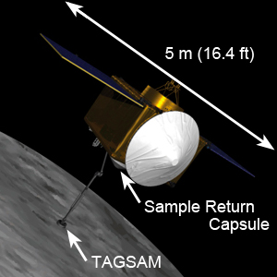
Spacecraft
http://osiris-rex.lpl.arizona.edu/images/osirisrex.jpg

Slide 9
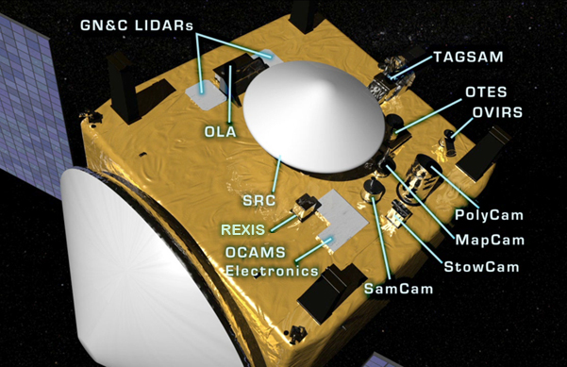
Instruments
http://osiris-rex.lpl.arizona.edu/sp_instruments.html

Slide 10
Significance of Results
Deep space exploration
Birth of the Solar System
Planet formation
Origins of life
Orbits of asteroid

Slide 11

Current Status
In March 2012, scientists discussed the details of the mission’s operations
Currently in Phase B of
the mission
At the end of March,
System Definition Reviews
(SDRs) began,
continuing throughout April
http://www.offthewallproject.org/2011/05/30/current-status-of-the-otwp-53011/

Slide 12


Current Status
SDR for each Instrument
Instrument SDRs lead to Mission Definition Review (MDR) in May
SDRs are critical for NASA’s Systems Engineering
Process to ensure the mission is a success
They are one of the key checkpoints
during Formulation
http://i.istockimg.com/file_thumbview_approve/17963123/2/stock-photo-17963123-may-2012-calendar.jpg
http://en.wikipedia.org/wiki/File:Checkmark.png

Slide 13
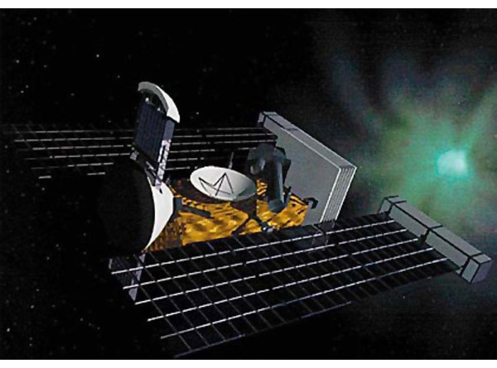
Next Steps
Finalize for Preliminary Design Review (PDR) in March 2013
After the transition to
Implementation, designs
are finalized and
spacecraft assembly
begins for final
launch in 2016
http://www.cankler.com.au/2011/12/14/nasa-osiris-rex/

Slide 14
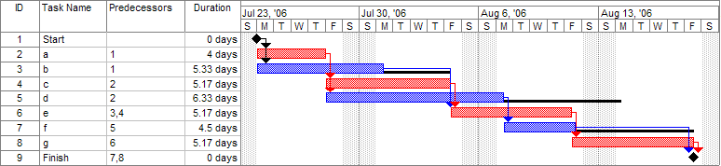
Importance of MS Project
Master Schedule maintained by Sr. Planning Specialist to merge the schedules for different systems
Track milestones to ensure mission is going as scheduled (Milestone Chart)
Rolling Wave Phenomenon Observed
http://en.wikipedia.org/wiki/Gantt_chart

Slide 15
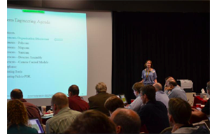
Systems Information
System administration
Networks
Maintenance
Visualization
http://osiris-rex.lpl.arizona.edu/images/news2.png

Slide 16
Systems Information
Security provisions
Telecommunications systems
Software (Control of Spacecraft)
Analysis of data

Slide 17

Summary
Characterize asteroid 1999 RQ36
Return and analyze pristine samples
Compare to data of entire asteroid population

Slide 18
A Special Thank You To
The Lunar and Planetary Department
The University of Arizona
The team at Michael Drake Building
Arizona Space Grant Consortium
Mr. James Rogers and Mr. Zachary Dolch
And of course our mentors!

Slide 19
THANK YOU!

